Slide 1
Input / Output Units
Kazi Masudul Alam

Slide 2
Reading Materials
Elements of Computer Science, S.K. Sarkar and A.K. Gupta

Slide 3
Input/Output Units
The input and output units of a computer are normally abbreviated as I/O units.
Computer systems use input devices for data entry purpose to enable a user to communicate with the machine.
The output unit transforms the result of the processed data into a form which can be read by people.
Together they are know as peripheral devices.

Slide 4
Input Units
Keyboard
Mouse
Joy Stick
Light pen
Track Ball
Scanner
Graphic Tablet
Microphone
Magnetic Ink Card Reader(MICR)
Optical Character Reader(OCR)
Bar Code Reader
Optical Mark Reader(OMR)

Slide 5
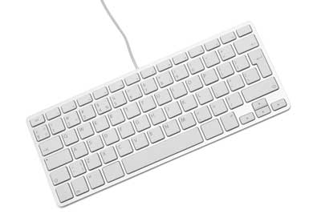
Keyboard
Sr.No | Keys | Description
1 | Typing Keys | These keys include the letter keys (A-Z) and digit keys (0-9) which generally give same layout as that of typewriters.
2 | Numeric Keypad | It is used to enter numeric data or cursor movement. Generally, it consists of a set of 17 keys that are laid out in the same configuration used by most adding machines and calculators.
3 | Function Keys | The twelve function keys are present on the keyboard which are arranged in a row at the top of the keyboard. Each function key has unique meaning and is used for some specific purpose.
4 | Control keys | These keys provide cursor and screen control. It includes four directional arrow keys. Control keys also include Home, End, Insert, Delete, Page Up, Page Down, Control(Ctrl), Alternate(Alt), Escape(Esc).
5 | Special Purpose Keys | Keyboard also contains some special purpose keys such as Enter, Shift, Caps Lock, Num Lock, Space bar, Tab, and Print Screen.

Slide 6
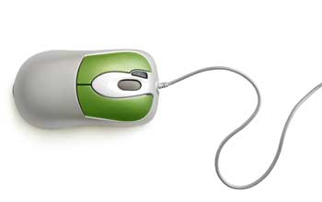
Mouse
Mouse is most popular pointing device. It is a very famous cursor-control device having a small palm size box with a round ball at its base which senses the movement of mouse and sends corresponding signals to CPU when the mouse buttons are pressed.
Generally it has two buttons called left and right button and a wheel is present between the buttons. Mouse can be used to control the position of cursor on screen, but it cannot be used to enter text into the computer.
Advantages
Easy to use
Not very expensive
Moves the cursor faster than the arrow keys of keyboard.

Slide 7
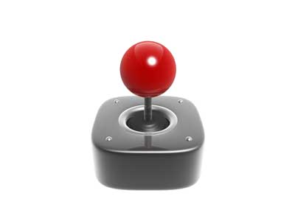
Joystick
Joystick is also a pointing device which is used to move cursor position on a monitor screen. It is a stick having a spherical ball at its both lower and upper ends. The lower spherical ball moves in a socket. The joystick can be moved in all four directions.
The function of joystick is similar to that of a mouse. It is mainly used in Computer Aided Designing(CAD) and playing computer games.

Slide 8
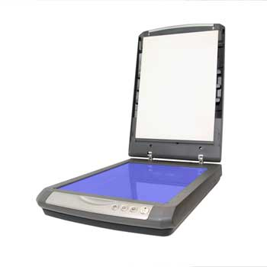
Scanner
Scanner is an input device which works more like a photocopy machine. It is used when some information is available on a paper and it is to be transferred to the hard disc of the computer for further manipulation. Scanner captures images from the source which are then converted into the digital form that can be stored on the disc. These images can be edited before they are printed.

Slide 9
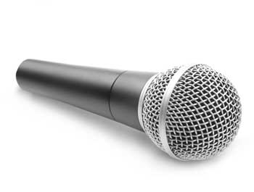
Microphone
Microphone is an input device to input sound that is then stored in digital form. The microphone is used for various applications like adding sound to a multimedia presentation or for mixing music.

Slide 10
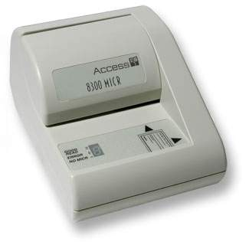
Magnetic Ink Card Reader(MICR)
MICR input device is generally used in banks because of a large number of cheques to be processed every day. The bank's code number and cheque number are printed on the cheques with a special type of ink that contains particles of magnetic material that are machine readable. This reading process is called Magnetic Ink Character Recognition (MICR). The main advantages of MICR is that it is fast and less error prone.

Slide 11
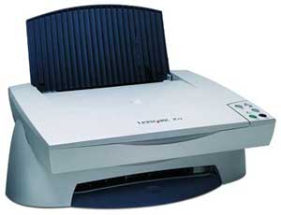
Optical Character Reader(OCR)
OCR is an input device used to read a printed text. OCR scans text optically character by character, converts them into a machine readable code and stores the text on the system memory.

Slide 12
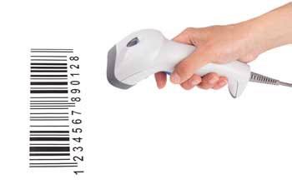
Bar Code Readers
Bar Code Reader is a device used for reading bar coded data (data in form of light and dark lines). Bar coded data is generally used in labelling goods, numbering the books etc. It may be a hand held scanner or may be embedded in a stationary scanner. Bar Code Reader scans a bar code image, converts it into an alphanumeric value which is then fed to the computer to which bar code reader is connected.

Slide 13
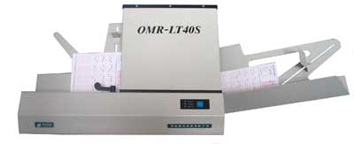
Optical Mark Reader(OMR)
OMR is a special type of optical scanner used to recognize the type of mark made by pen or pencil. It is used where one out of a few alternatives is to be selected and marked. It is specially used for checking the answer sheets of examinations having multiple choice questions.

Slide 14
Output Units
Important output devices which are used in a computer.
Monitors
Graphic Plotter
Printer

Slide 15
Output Units
Monitors
Monitors, commonly called as Visual Display Unit (VDU), are the main output device of a computer. It forms images from tiny dots, called pixels that are arranged in a rectangular form. The sharpness of the image depends upon the number of pixels.
There are two kinds of viewing screen used for monitors.
Cathode-Ray Tube (CRT)
Flat- Panel Display

Slide 16
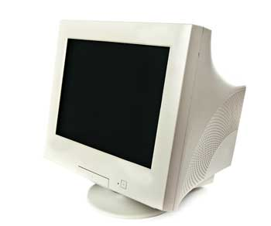
Cathode-Ray Tube (CRT) Monitor
The CRT display is made up of small picture elements called pixels. The smaller the pixels, the better the image clarity, or resolution.
Most screens are capable of displaying 80 characters of data horizontally and 25 lines vertically.
There are some disadvantages of CRT:
Large in Size
High power consumption

Slide 17
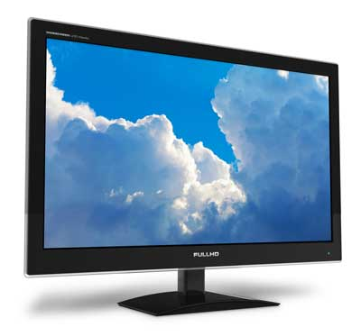
Flat-Panel Display Monitor
The flat-panel display refers to a class of video devices that have reduced volume, weight and power requirement in comparison to the CRT. You can hang them on walls or wear them on your wrists. Current uses of flat-panel displays include calculators, video games, monitors, laptop computer, graphics display.
LED(Light-Emitting Diodes).
LCD(Liquid-Crystal Device)

Slide 18
Printers
Printer is an output device, which is used to print information on paper.
There are two types of printers:
Impact Printers
Non-Impact Printers

Slide 19
Impact Printers
The impact printers print the characters by striking them on the ribbon which is then pressed on the paper.
Characteristics of Impact Printers are the following:
Very low consumable costs
Very noisy
Useful for bulk printing due to low cost
There is physical contact with the paper to produce an image
These printers are of two types
Character printers
Line printers

Slide 20
Non-impact Printers
Non-impact printers print the characters without using ribbon. These printers print a complete page at a time so they are also called as Page Printers.
These printers are of two types
Laser Printers
Inkjet Printers
Characteristics of Non-impact Printers
Faster than impact printers.
They are not noisy.
High quality.
Support many fonts and different character size.

Slide 21
☺

